Slide 1
Royal St. George Yacht Club
Annual Oscar Sailing Awards

Slide 2
Award Categories
The Commodores Cup (Best offshore performance)
Vice Commodores Cup (Significant dinghy performance)
O’Hanlon Cup (Best cruise)
Enriquetta Cup (Significant keelboat performance)
Causeway Trophy (For Sportsmanship)
Youth Trophy (Significant Contribution to the Club by a Youth Sailor)

Slide 3
Commodores Cup
Best Offshore Performance

Slide 4
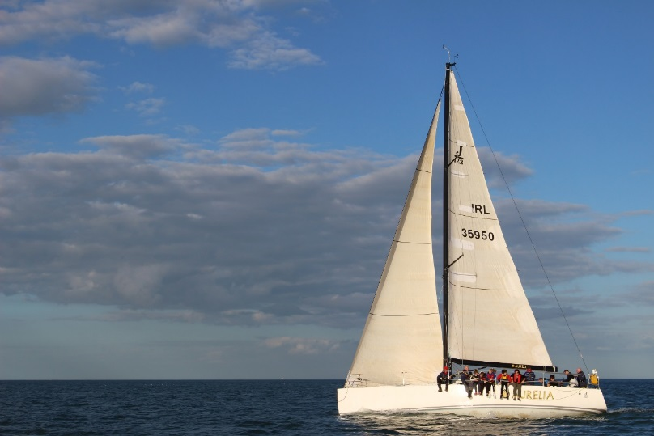
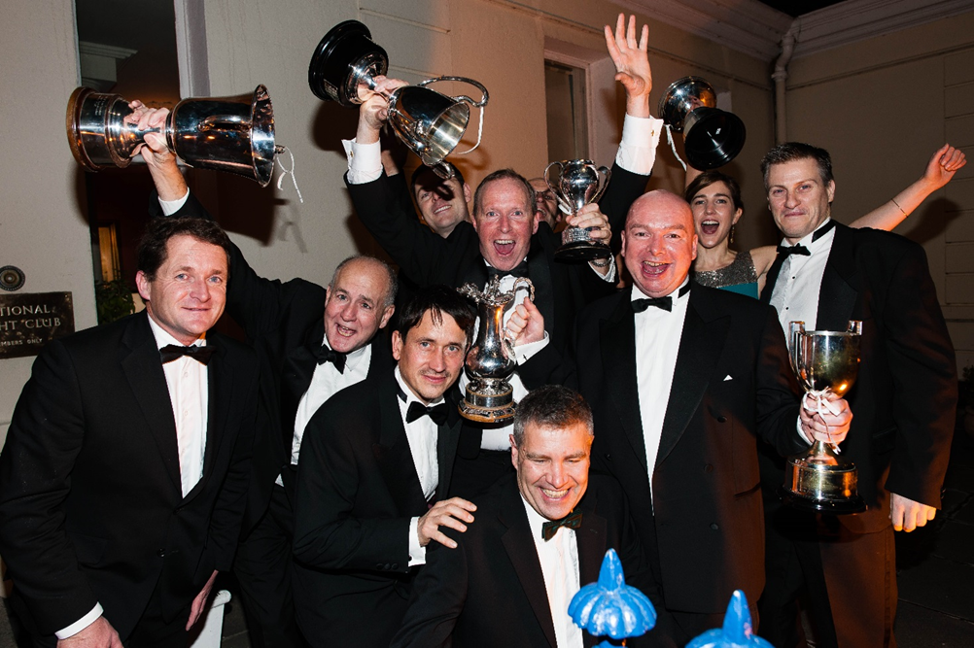
Commodores Cup
Chris Power-Smith
Aurelia & ISORA
Strong fleet of over 50 boats.
2 bullets
6 top 3 finishes
12 races in 3rd overall.
Volvo Round Ireland –
18th overall.

Slide 5
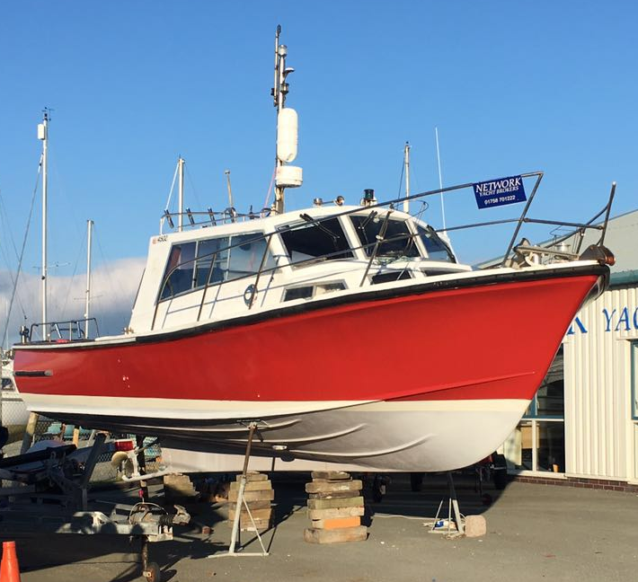
Arrival of New Committee Boat

Slide 6
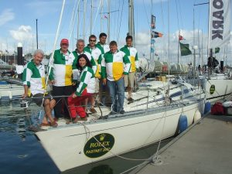
Commodores Cup
Jerry Collins
Persistance and the Round Ireland
7 Times Round Ireland
2016 – 4th in class of 65
19th Overall
DBSC
Leading boat IRC in White Sails
Other Accomplishments
4 Fastnet races
2 Sydney Hobart races

Slide 7
Vice Commodores Cup
Significant Dinghy Performance

Slide 8
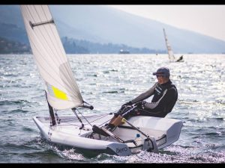
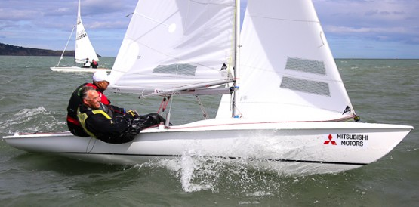
Vice Commodores Cup
Sean Craig
1st overall at the Flying 15 Southern Championship
8° RS AEROCUP : MALCESINE, LAKE GARDA, ITALY

Slide 9
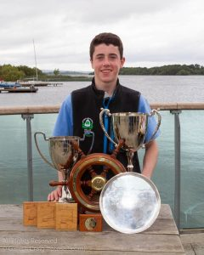
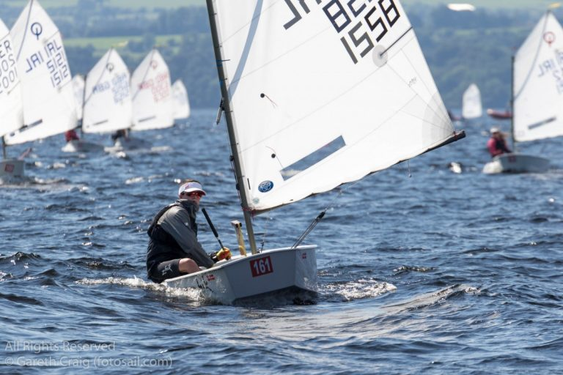
Vice Commodores Cup
Tom Higgins
Multi- champion in the Optimist:
1st - Irish National Championships
1st - Optimist British Open National a feat never before achieved by an Irish sailor.
Nominated Irish Youth Sailor of the Year

Slide 10
Laser Masters World Championships 2018
40+ nations
Typically 400 sailors
September 2018
Chilled atmosphere
Some big talk in the bar….
RSGYC Masters out in force.

Slide 11
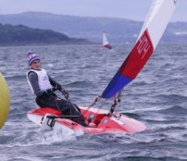
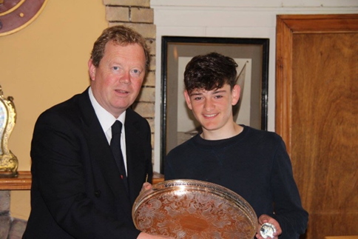
Vice Commodores Cup
Jack Fahy
1st Irish Topper National Championships.
6th Topper Worlds at Ballyholme YC.
3rd Laser Nationals, 4.7 fleet

Slide 12
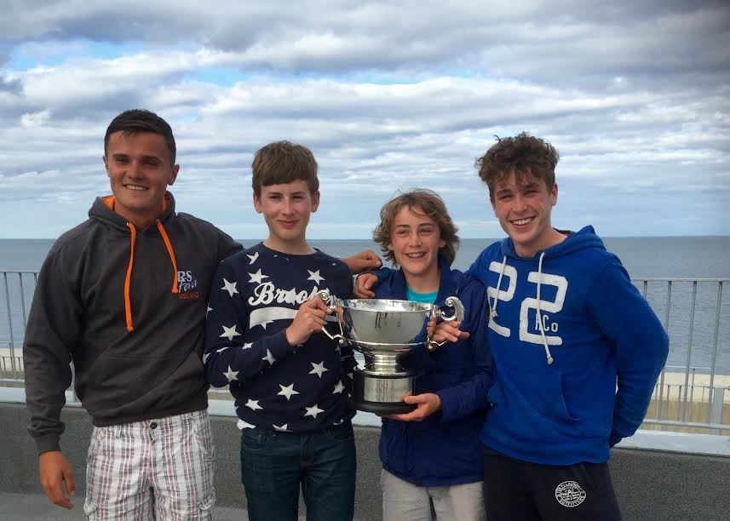
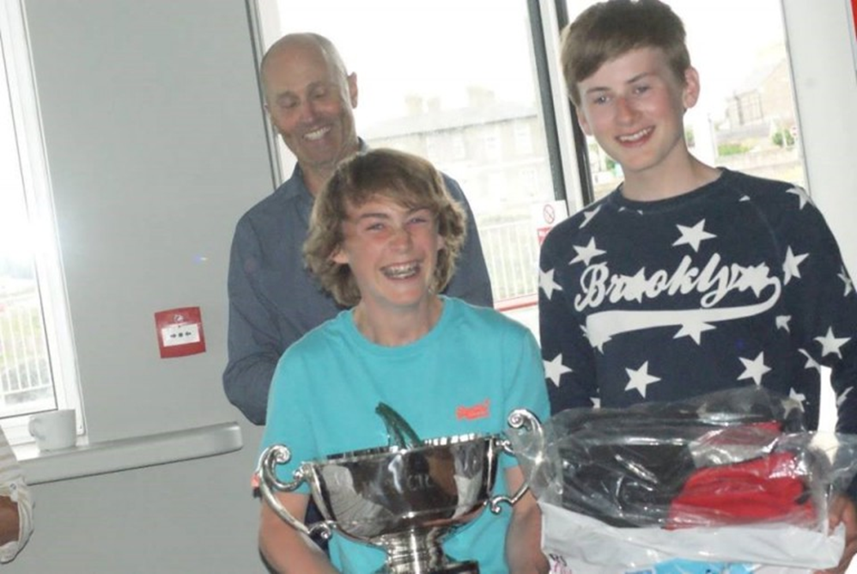
Vice Commodores Cup
Henry Start and Morgan Devine
2016 has been a very successful year for the RS Feva class, Remains the most popular junior double hander at the club.
1st the Eastern Championships- RSGYC
1st nationals Championships GSC in 38 boat fleet.

Slide 13
O’Hanlon Cup
Best cruise of 2016

Slide 14
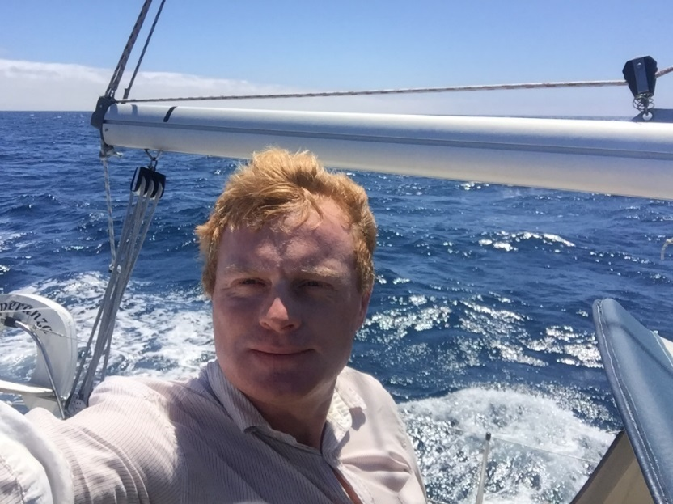
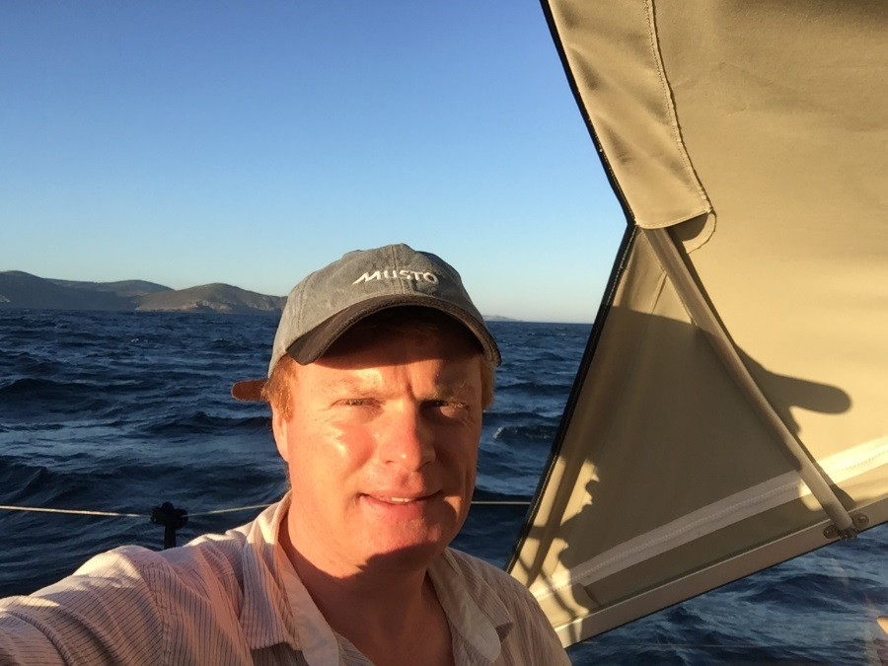
O’Hanlon Cup
Alan McMahon
Single handed Sail from Galacia NW Spain across Biscay to Dun Laoghaire non-stop. 660 miles over 6 days.
.

Slide 15
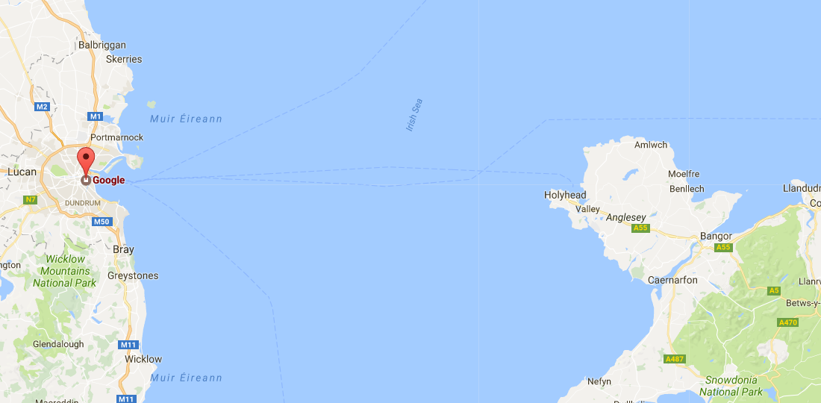
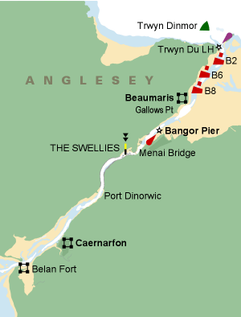
Anglesea
Cruise
2017
May Bank Holiday weekend
Thurs / Fri 29th – Monday May 1st
Dun Laoghaire
Caernarfon
MANAI STRAITS
Beaumaris
Holyhead
Dun Laoghaire

Slide 16
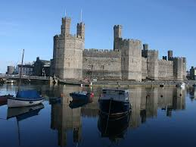
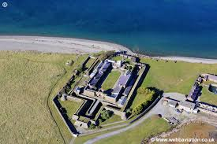
Caernarfon Castle
Fort Belan

Slide 17
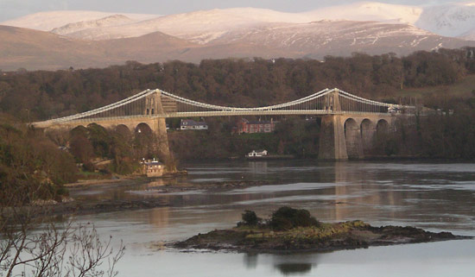
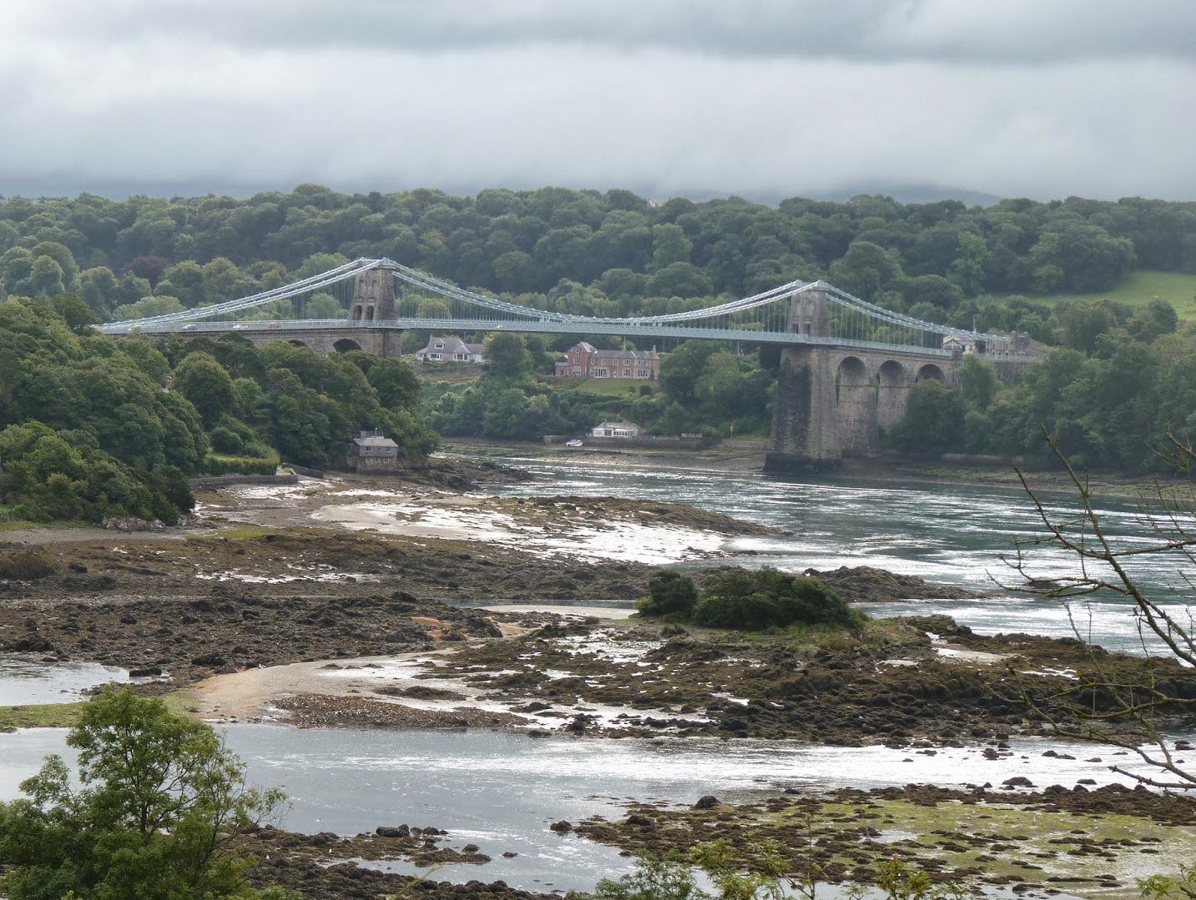
Half-tide
Low-tide

Slide 18
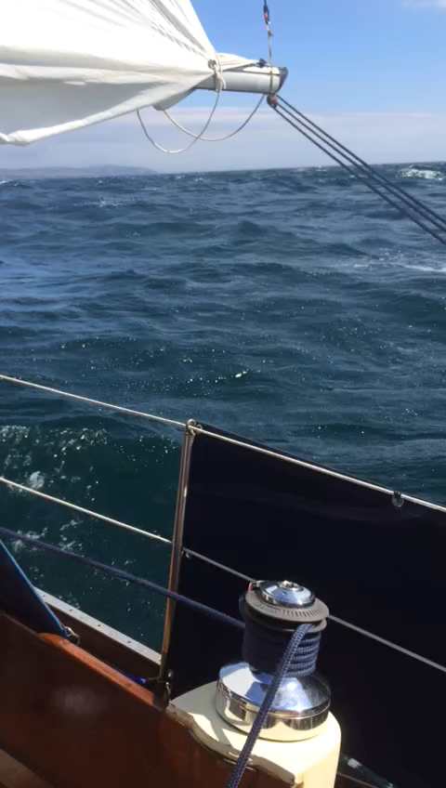
Isle of Man Cruise

Slide 19
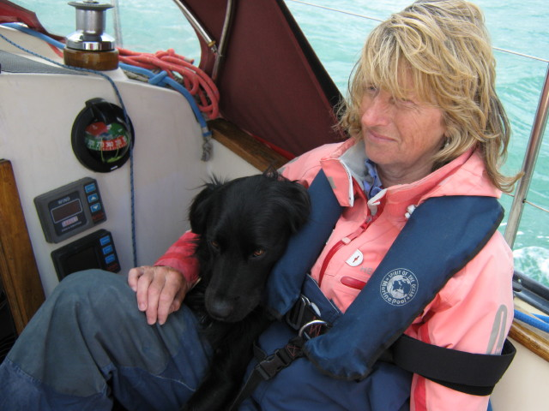
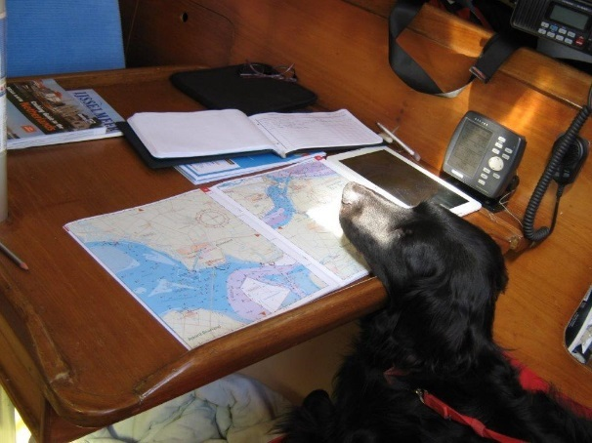
O’Hanlon Cup
Christine Heath
Gusto Trip 2016
Christine, crew plus Nimbus the dog, sailed 900 miles in a Shipman 28.
From the George pontoon to Friesland in Holland,
34 harbours, Coped with engine failure, fog, & lots of commercial shipping and sand banks.
Travelled through Holland via canal to Heeg
More to come in 2017………….

Slide 20
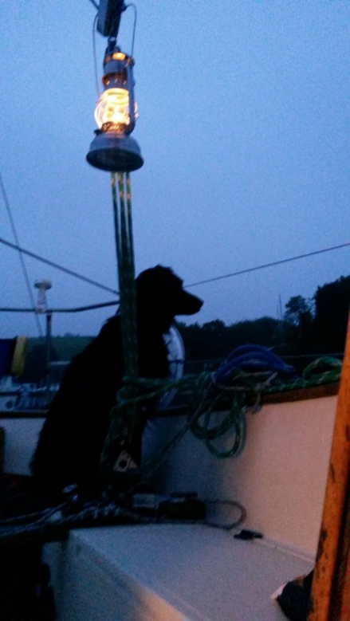
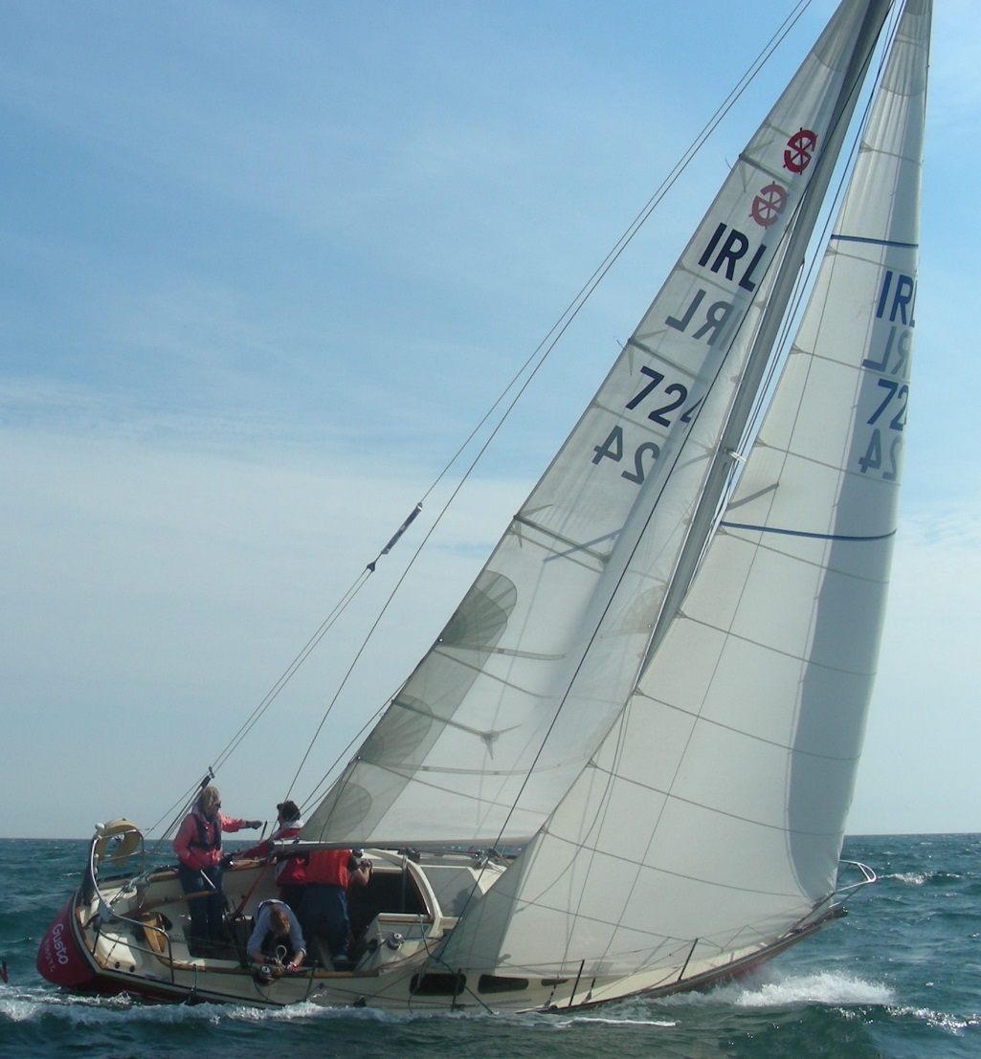
Gusto
Nimbus

Slide 21
Enriquetta Cup
Significant Keelboat Performance

Slide 22
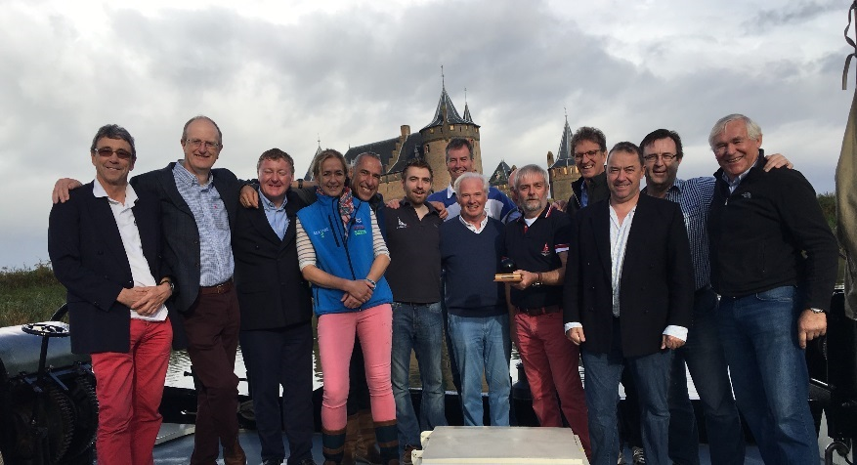
Enriquetta Cup
Cannonball Trophy Team
Peter Bowring, Paul Maguire, Martin Byrne, Tim Pearson, Marcus Pearson & John OConnor. Missing are Ailbe Millerick(umpire) Charlie Bolger (1st sub) and Gerbil Owens (technical adviser).
The RSGYC Cannonball Trophy squad for their triumphant victory in Muiden, Netherlands. The annual team racing event sailed by Dragon sailors from The Royal London Yacht Club in Cowes, The Royal Netherlands Yacht Club in Muidan Holland and The Royal St George Yacht Club .
The original trophy, which was mislaid about ten years ago, was a cannonball taken by the Dutch from a captured British ship in 1667 after the raid on the Medway and the current trophy is a cannonball (mounted on a hardwood base) which was fired from a British gun possibly by an Irish artilleryman at the Dutch in Java in 1811 so this event has quite a lot of history and inter nation rivalry

Slide 23
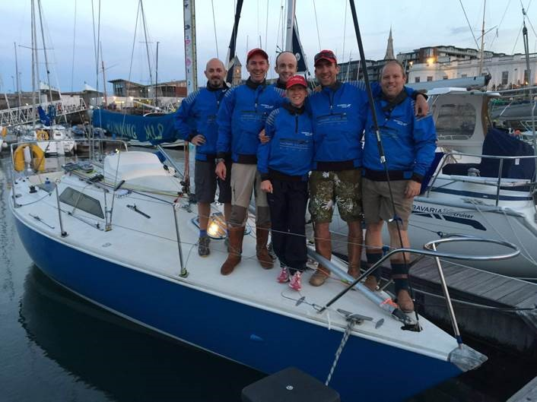
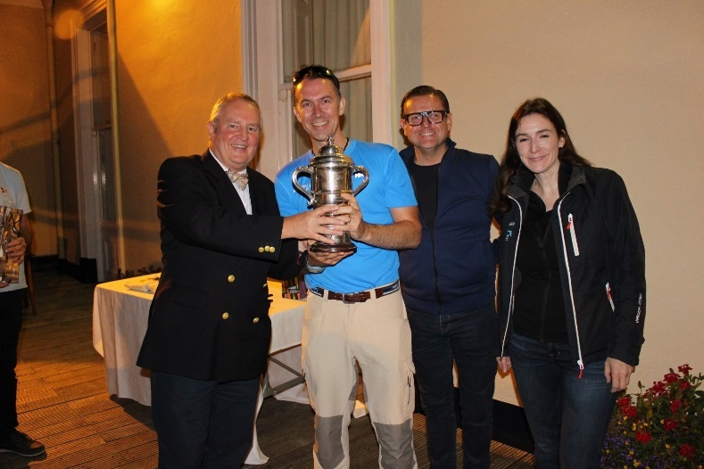
Enriquetta Cup
Brendan Foley
Running Wilde Team
2016 was a great season for Running Wilde;
Royal St George Regatta IRC and Echo (Cruiser 3)
Royal St George End of Season Race ‘Shindilla Cup’
DBSC Viking Marine Trophy – 1st Thursday Nights Overall IRC (Cruiser 3)
DBSC Smalldridge Trophy – 1st Thursday Nights Overall Echo (Cruiser 3)
DBSC Series 1, Series 2 on both IRC and Echo (Cruiser 3)
DMYC Kish Race 3rd overall IRC (All classes)

Slide 24
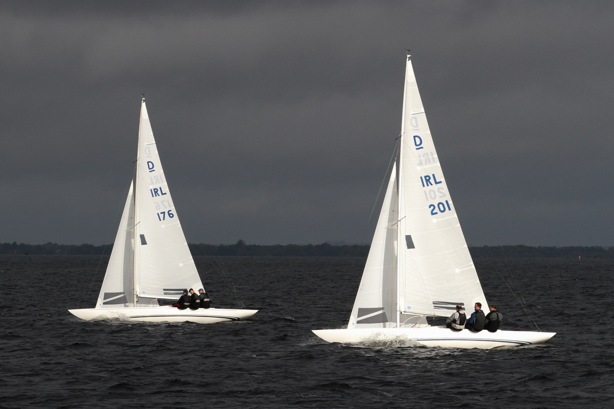
Phantom and Jaguar

Slide 25
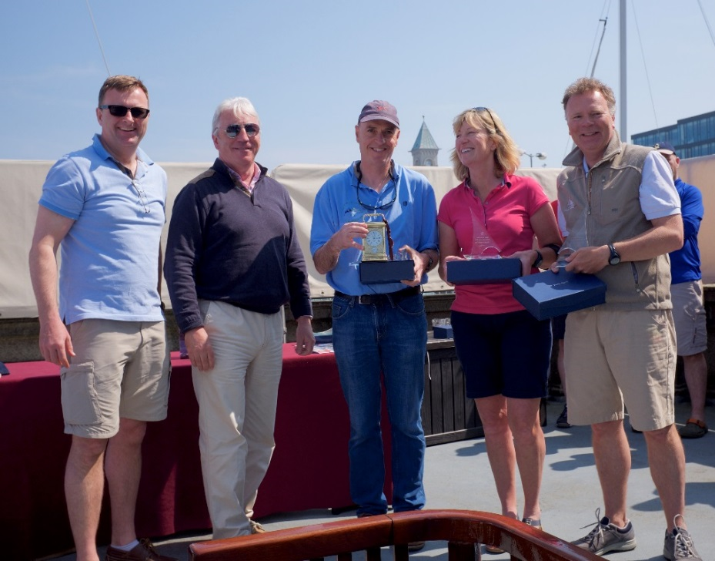
Enriquetta Cup
Peter Bowring & crew
Phantom
1st East Coast Champions,
5th in Edinburgh Cup,
Dublin Bay winners 2016

Slide 26
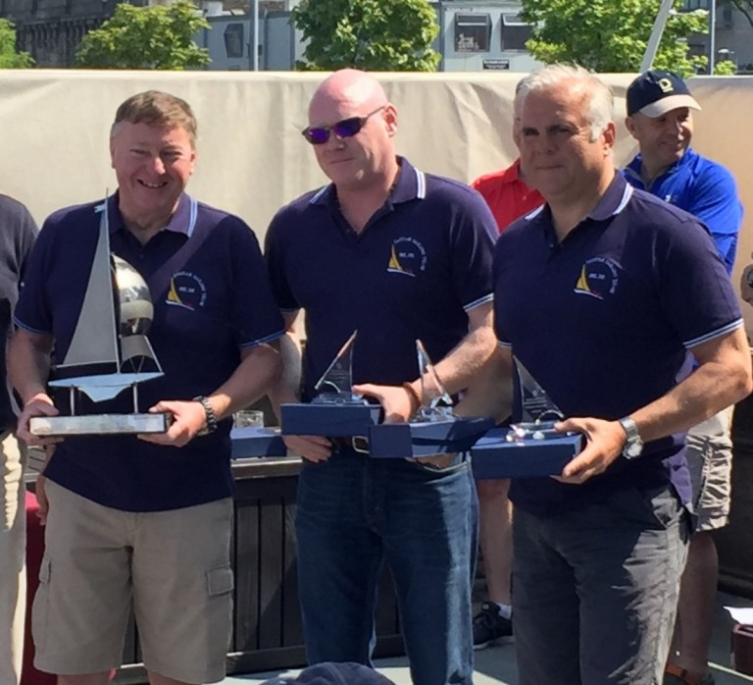
Martin Byrne & Team Jaguar
1st National Championship
4th in Edinburgh Cup,

Slide 27
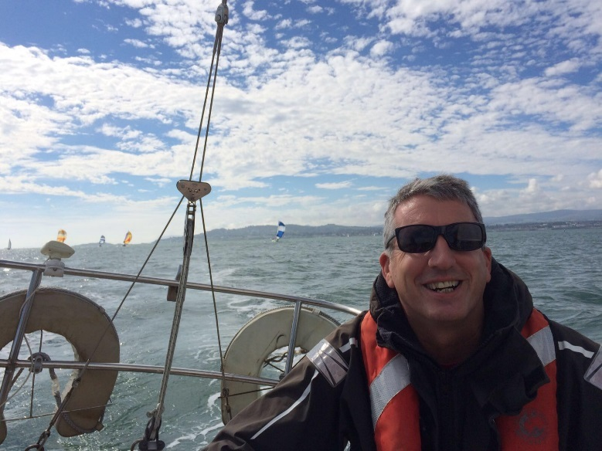
Enriquetta Cup
Fergus Mason & Viking
"Viking”, a Shipman 28, sail No 409, was bought in 1999, by Dr. John Mason in partnership with 4 others, including Brian Glynn, Tuffet McWeeney and Mick Flynn.
Fergus crewed for many years, and took over the helm and partnership in 2005, on the death of his father.
Many new crew and associates over the years.
Prizes won in 2016
The George Arthur Newsom Memorial Cup for most successful boat in one design
The Malindy Cup for overall Saturdays DBSC
Shipman Class Midweek Cup
The inaugural RAYC/DBSC COSTAL RACE SERIES Trophy
DBSC Thursday series 1 and series 2 DBSC Sat series 2 and overall.

Slide 28
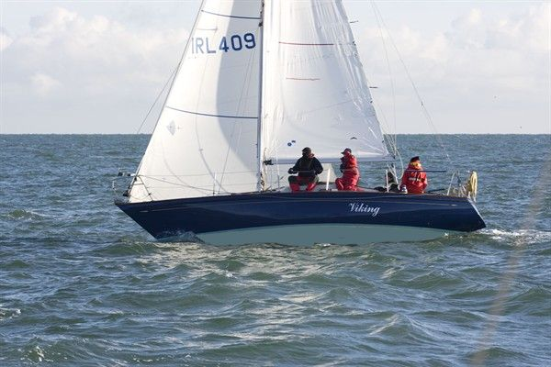
Viking

Slide 29
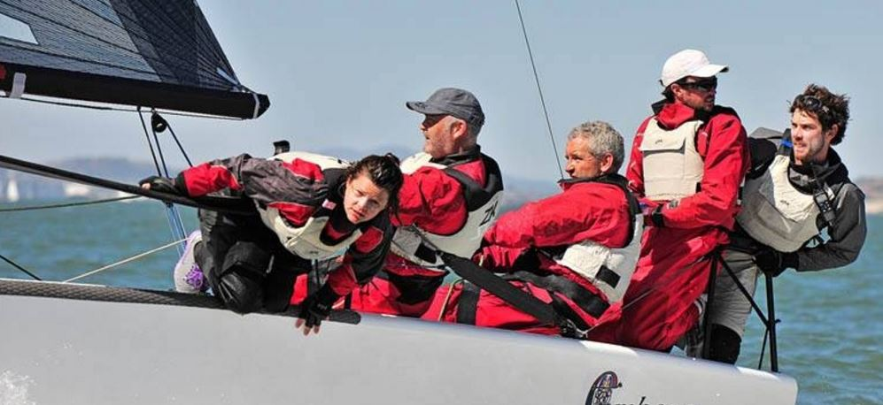
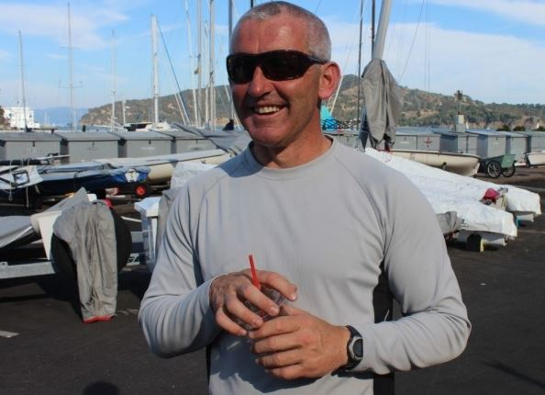
Enriquetta Cup
Prof O’Connell
1. Melges 24 World Championships aboard IRL 829 "Embarr" - 1st (spinnaker trimmer and strategist)
2. Round Ireland Race aboard J109 "Euro Car Parks" - 1st in class, 5th overall (helmsman and watch leader)
3. IRC Nationals aboard "Jump Juice" - 1st IRC 0 (mainsheet trimmer and strategist)

Slide 30
Causeway Trophy
For Sportsmanship

Slide 31
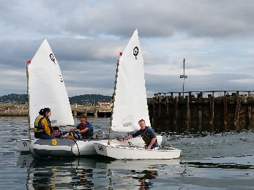
Causeway Trophy
Rachel Donohoe
Rachel volunteered to be an instructor 11 years ago when the WeSail programme for adults was introduced in 2006. Since then she has been fully committed to teaching sailing skills, to WeSail athletes, on Monday nights through the summer from May to end of August.
She adapts the programme according to the needs of the athletes and availability of support. She sourced instructors from family and friends when we could find no one.
We Sail has grown from 4 athletes to eight last year and probably 10 this year. They are supported by instructors and knowledgeable sailors with rib licences.

Slide 32
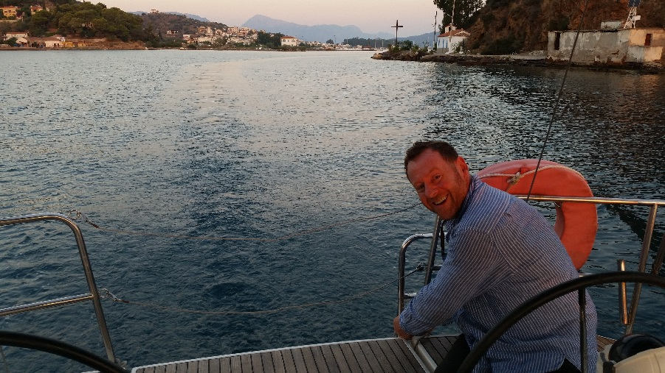
Causeway Trophy
Conor O’ Leary
Connor is the person you want to have around because not only does he bring great enthusiasm to sailing but will drop everything to help others.
A very enthusiastic laser and squib sailor and any other boat he can get on to .
He brings great fun and laughter to the WeSail group where his contribution is invaluable as he encourages and demonstrates how to capsize and right a laser or topper and then helps the athletes to achieve the same.
His presence always lightens the mood as he is full of fun and jokes.

Slide 33
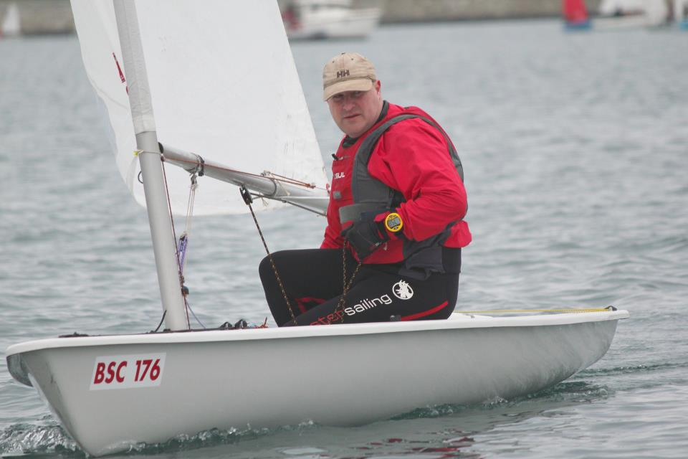
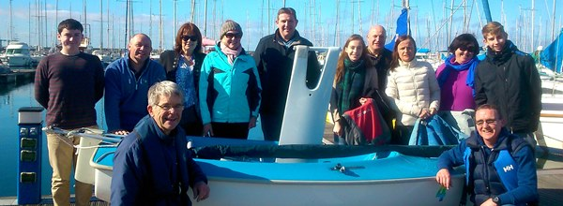
Causeway Trophy
Alain Deladiennee
Sailability
Helps run the Sailability programme at the Club on Sunday mornings.
These courses are run over the summer for children with physical and sensorial disability
Last year he initiated and ran more or less on his own a pilot course for adults with disability on Sunday afternoons. This was such a success that he is going to run a full course this season.
The Club and Dun Laoghaire Sailability owe a huge debt of gratitude to Alain.
He is an example of volunteerism at its best

Slide 34
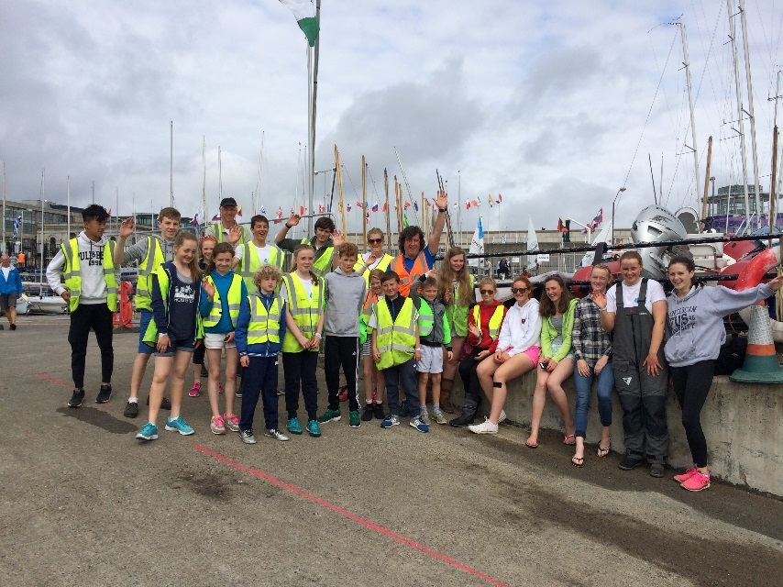
Causeway Trophy
The Little Family
Their tireless work at KBC Laser Radial World Championships

Slide 35
Youth Trophy
Significant Contribution to the Club by a Youth Sailor

Slide 36
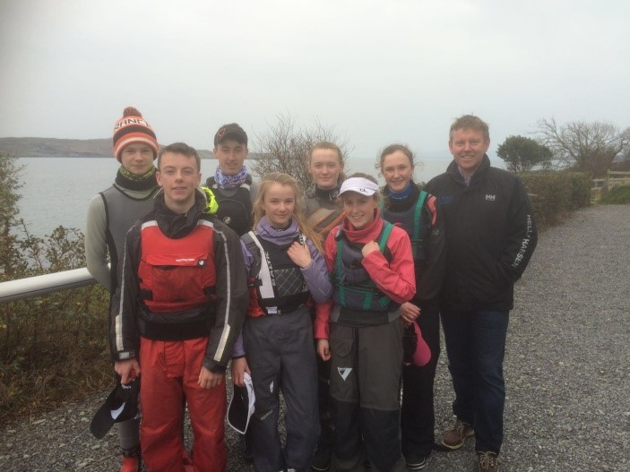
Youth Trophy
Greg Arrowsmith
Greg has been one of the driving forces behind the growth of team racing amongst our youth sailors over the past 2 years.
Following on from the inaugural Elmo Trophy in 2015, he organised a young RSGYC team at the International Schools Team Racing Championships in Schull in April 2016.
He organised training throughout the summer in the run up to the 2016 Elmo Trophy and also put together a youth team from the George to compete in the National Team Racing Championships in November.
Over the winter, he has set up and run a team racing training programme for his school, St. Andrews College, with 25 sailors enjoying some great coaching and lively sessions on the water.
Along with RCYC, Greg organised a one day RSGYC vs RCYC Team Racing Challenge, with 3 teams from each club due to compete against each other.
Greg has entered a George Youth team for the Wilson Trophy in West Kirby in May,

Slide 37
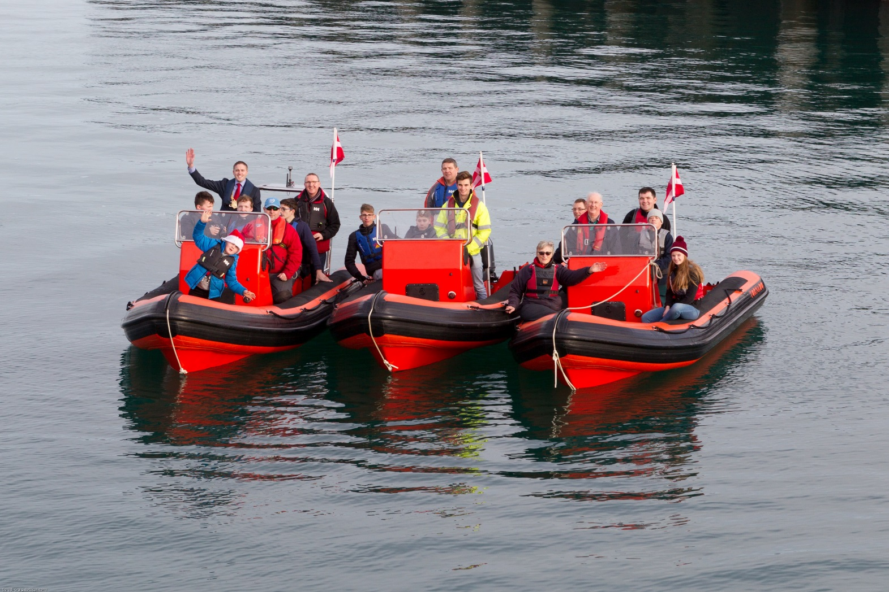
RSGYC Tornado Ribs

Slide 38
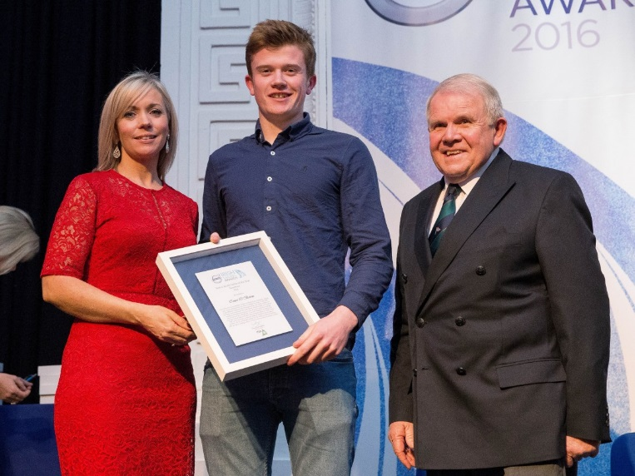
Youth Trophy
Conor O’Beirne
Nominated for the ISA Youth Sailor of the year award.
12th place finish at the Laser Radial Worlds 2016.
Captained Team Ireland at the KBC Radial Youth Worlds, who had their most successful year in history in 2016.
1st Youth National Championships 2016 Laser Radial. ( Also 1st in 2015 - first time it has been retained.

Slide 39
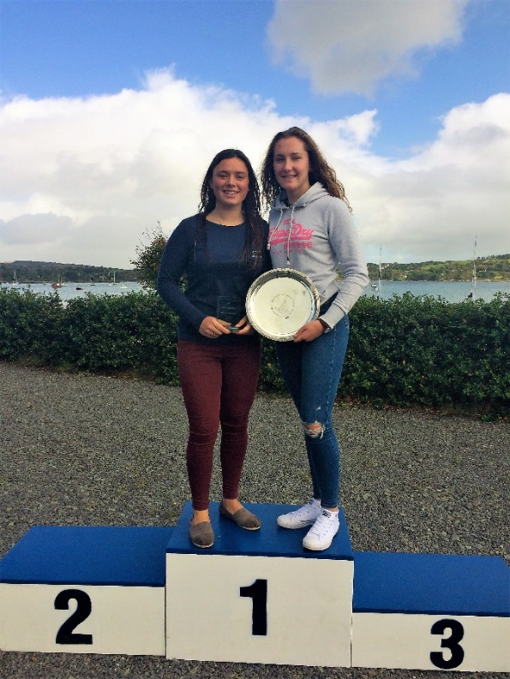
Youth Trophy
Kate Lyttle and Niamh Henry
1st Irish 420 Ladies National Champions in 2016.
Kate and Niamh were selected to sail in the All Ireland Junior Championship in Schull.
After very tight racing she won the All Ireland Junior Ladies Championship, making her top junior ladies sailor in Ireland.
Previous winners include Annalise Murphy.

