Slide 1
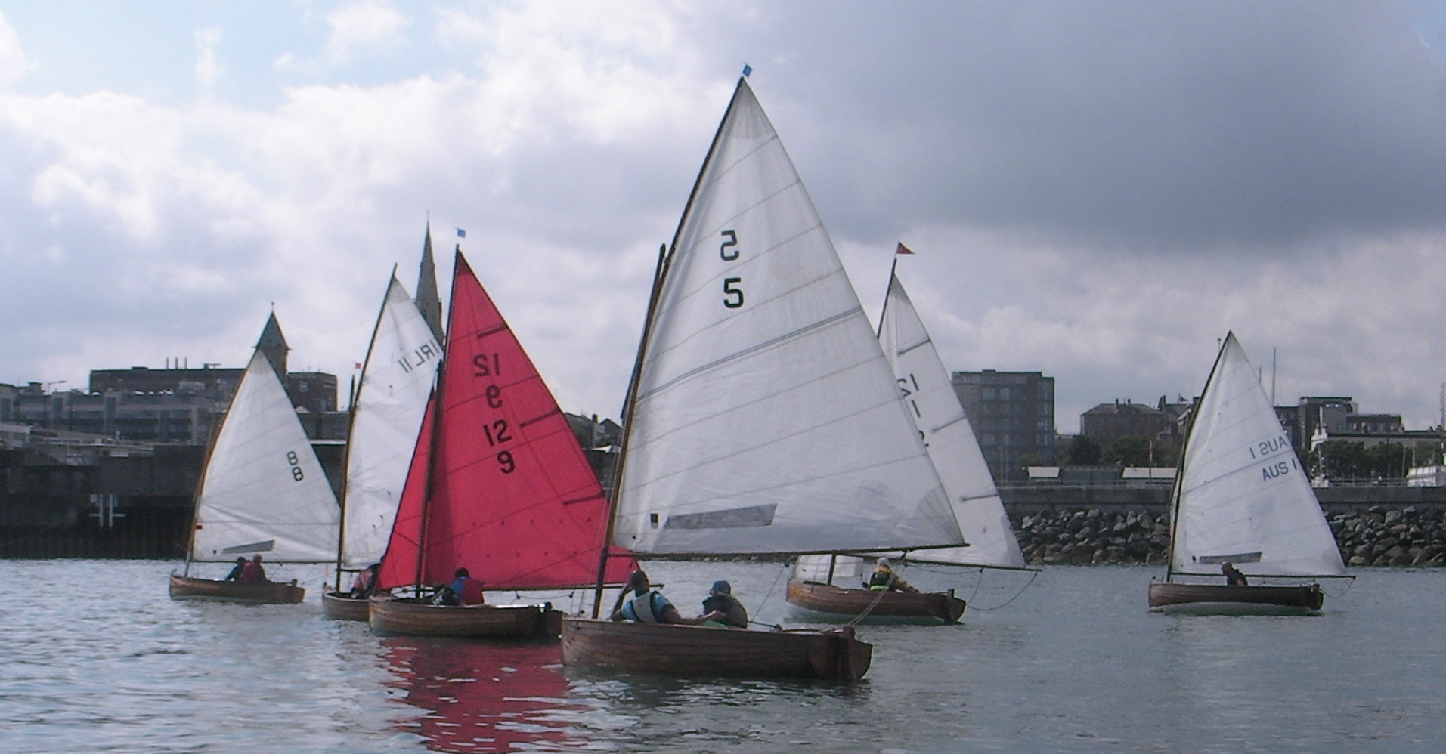
IRISH INT. 12 ft. DINGHY & D.B.S.C. 12 ft. CHAMPIONSHIPS
Royal St.George Yacht Club, Dun Laoghaire
26 August 2018.
For more information contact:
Vincent Delany at 086 857 5374
or Sailing@RSGYC.ie

